Slide 1
Human Ecological Theory
Ch. 6

Slide 2
Basic Assumptions
Human beings and groups are a product of both _____and environment
  Instead of Nature vs. Nurture
  Nature through Nurture
  Environments can _______ developmental possibilities

Slide 3
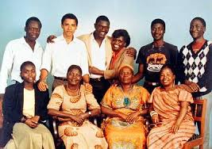
Family Photo Barak Obama

Slide 4
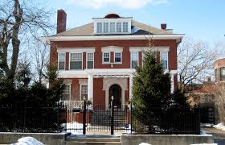
Chicago Home

Slide 5
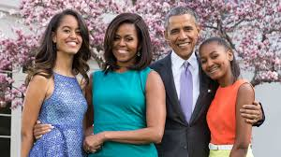
Basic Assumptions

Slide 6
Basic Assumptions
    Environments can also _____or constrain behavior and development
Obama’s younger half brother had a different environment: 3:41
https://www.youtube.com/watch?v=B_NmmimuHsc

Slide 7
Basic Assumptions
How did their respective environments contribute to or limit their development?
How will the current environment influence the _______ (ontogenetic) development of Maneeya, Ansley and Najac? (mom & kids)

Slide 8
Basic Assumptions
Humans are __________ upon their environment to meet their biological needs
  What happens right before a big snow storm here?

Slide 9
Basic Assumptions
  Quality of life depends ______ on environment
    How is quality of life measured? Adequacy of basic ____ and reaching goals
    Describe the quality of life of Maneeya, Yanik and family.

Slide 10
Quality of Life
Objective Measures:
  Individual?
    Personal health
  Familial?
    Housing quality
    __________
  Societal?
    Access to healthcare
    _____________
Subjective Measures
  Individual? _______________
  Familial?
    Marital/family satisfaction/closeness
  Societal?
    Nationalism
    Racism

Slide 11
Think about your own quality of life
Objective Measures:
  Individual?
  Familial?
  Societal?
Subjective Measures
  Individual?
  Familial?
  Societal?

Slide 12
Basic Assumptions
As social beings, humans are _______ on others
  How are we dependent within group assignments?
  How are we dependent on others within families?

Slide 13
Basic Assumptions
As social beings, humans are _______ on others
  How are we dependent on others globally?
  How does Think Global. Act local illustrate the idea of interdependence?
  Ex. True Cost documentary

Slide 14
Basic Assumptions
Human beings are ______, such that time is both a limitation and a resource.
  How is time a limitation?
  How is time a resource?

Slide 15
Basic Assumptions
Humans _______ their interactions within their spatial environments
  How does a spatial arrangement channel human interactions?
    In the classroom? Here vs. C-90?
    Personal space bubble?

Slide 16
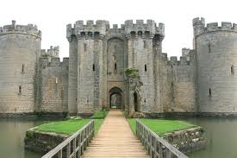
Outside of a castle?

Slide 17

In a throne room?

Slide 18

On the couch?

Slide 19
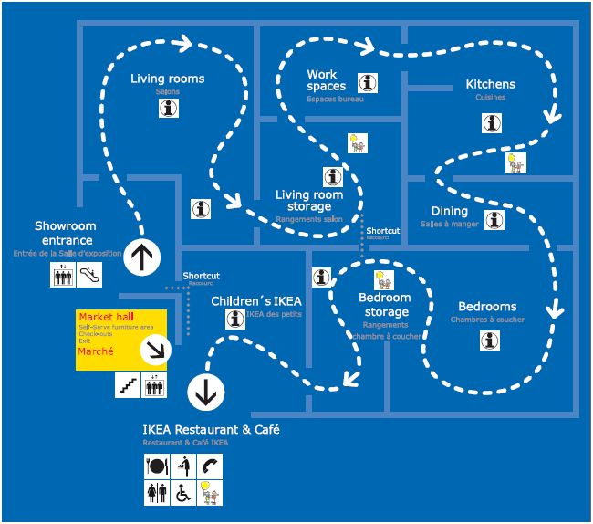
IKEA?

Slide 20
In a house?
Corny Country Song to Illustrate: (3:38)
https://www.youtube.com/watch?v=4xCdyMq6z1c

Slide 21
Basic Assumptions
Human behavior can be comprehended on at least two levels: _________ and population
  Individual: how well does one adapt or not to their environment?
  E.g., Man vs. Wild

Slide 22
Basic Assumptions
Human behavior can be comprehended on at least two levels: individual and _________
  Population:
    Spatial organization such as population density, population growth, metro vs. rural, etc.
    Distribution of characteristics among groups
      E.g., infant mortality rates, fertility, marriage, divorce

Slide 23
Systems
_____system—immediate environment of developing person
  Examples from the vignette?
    Live in fear in make-shift tent with millions of others
    Live in a small intergenerational family with a widow, young mother and two small children

Slide 24
Systems
______system—the link or interaction between two microsystems
  Examples from the vignette?
    No work at the hotel due to damage leads to unemployment and scarce resources for the family
    Family lives in fear because their neighborhood is unsafe

Slide 25
Systems
_____system—settings or institutions not experienced directly by the person, but which can influence development in indirect ways.
  Examples from the vignette?
    Police (or lack of) to prevent sexual assault
    Relief agency that provides the tents

Slide 26
Systems
______system—customs, attitudes, ideologies, values and laws of a culture
  Examples from the vignette?
    Important to support family and sacrifice for future generations
    Important to work

Slide 27
Systems
______system—one’s developmental history situated within one’s environment
Before and after the Haiti earthquake
The great recession
The war on terror
Election and re-election of first African American President

Slide 28
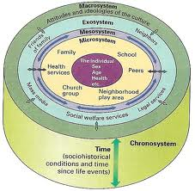

Slide 29
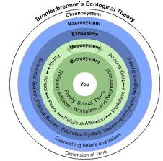

Slide 30
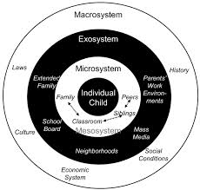

Slide 31
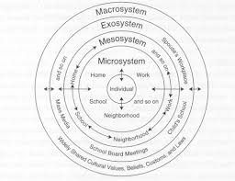

Slide 32
Application Activity: Describe your own systems
Micro—
Meso—
Exo—
Macro—
Chrono—

